Slide 1
Utah Lake and Nutrient Loading LaVere B. Merritt Prof. Emeritus, BYU 30 March 2017
Utah Lake Nutrients

Slide 2
Utah Lake Nutrients
Utah Lake’s nature:
shallow
slightly saline
turbid
eutrophic
in semi-arid region
Indications are that the lake has been this way since it stabilized after Lake Bonneville last receded some 8000 to10,000 yrs ago.

Slide 3
Utah Lake Nutrients
Eutrophication might be generally defined as:
Increasing aquatic plant growth and overall biological productivity in a water body over the years.
Sometimes this results in significant losses in water quality.
Natural eutrophication usually takes hundreds or thousands of years, or more. but is often accelerated by human activities.

Slide 4
Utah Lake Nutrients
Trophic level classification for lakes:
Oligotrophic (low bio-productivity, clear )
Mesotrophic (moderate “ ,slightly turbid)
Eutrophic (high “ , turbid )
Hyper eutrophic (very high “ , very turbid )
Turbidity as used here is mainly due to increased algae and other biological organisms in the water—biological turbidity.

Slide 5
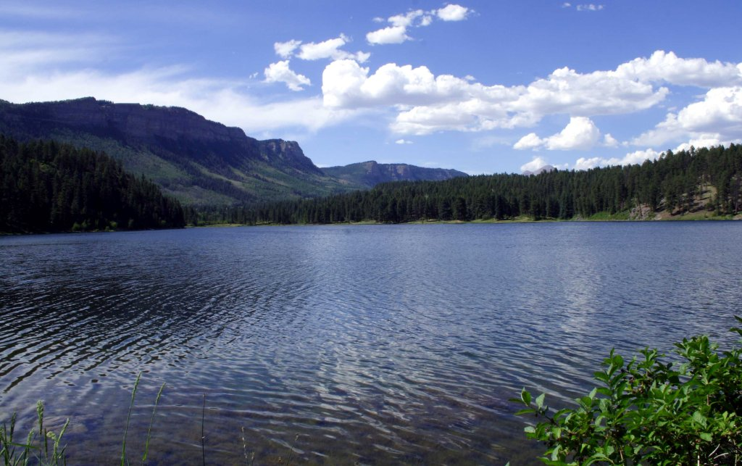
Utah Lake Nutrients
An oligotrophic lake

Slide 6
Utah Lake Nutrients
A mesotrophic lake

Slide 7
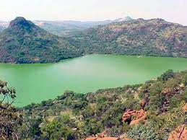
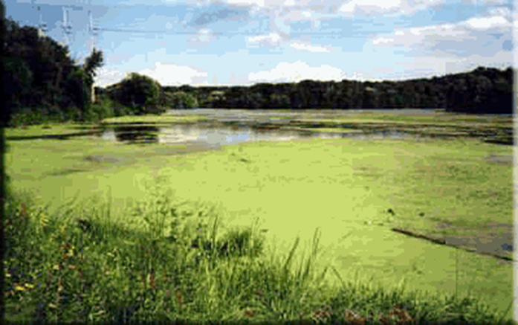
Utah Lake Nutrients
Eutrophic lakes

Slide 8
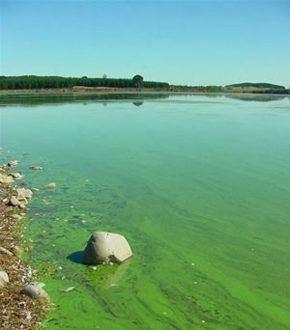
Utah Lake Nutrients
A hyper-eutrophic lake

Slide 9
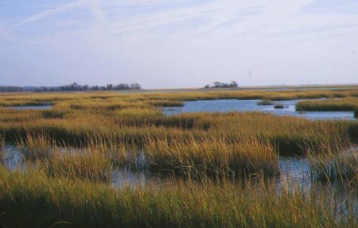
Utah Lake Nutrients
Most lakes eventually become marshland—then meadows—then “basin” land

Slide 10
Utah Lake Nutrients
Types of problems that might occur in eutrophic lakes:
Turbid water from prolific algal and other biological growth
Significant floating algae and other bio-debris
Accumulations of unsightly bio-debris along shorelines
Loss of oxygen—sometimes total loss—”normal” biota stressed.
“Mucky”, often septic, conditions at the bottom
Bad odors
Heavy swarms of insects and aquatic bugs
Conditions that favor “coarser” fish and other aquatic life
“Troublesome” residual decomposition compounds in the water

Slide 11
Utah Lake Nutrients
But note—Most of the “problems” with eutrophic lakes relate to on-site aesthetics and recreation—and generally not to primary water quality concerns with public health or community sanitation (disease and filth).
I.e., most eutrophic issues relate to
“How pristine and scenic is the lake?”
“does it look good and smell okay?”
We all like pristine, clear waters along with their amenities, but even with no changes by humans most waters have considerable “aesthetic quality” problems. I.e., most lakes naturally have some of the problems associated with “eutrophic” conditions.
Rivers/steams can also have algae-caused water quality problems but usually to a lesser extent that lakes do.

Slide 12
Utah Lake Nutrients
Main factors determining plant growth:
Light (sunshine)
Nutrients (phos., nitro., other vitamins and minerals)
Toxicants
Temperature
Time
Variability in factors
Competition
Grazing/Harvesting

Slide 13
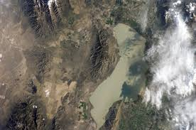
Utah Lake Nutrients
Man
Was
Her
E

Slide 14
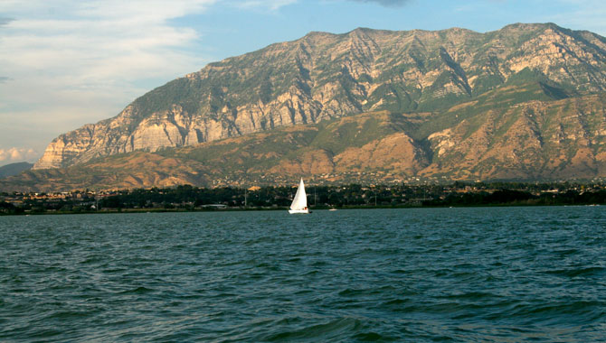
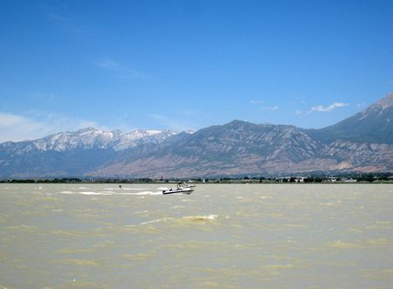
Utah Lake Nutrients
Typical turbidity during the summer
Conditions on Utah Lake

Slide 15
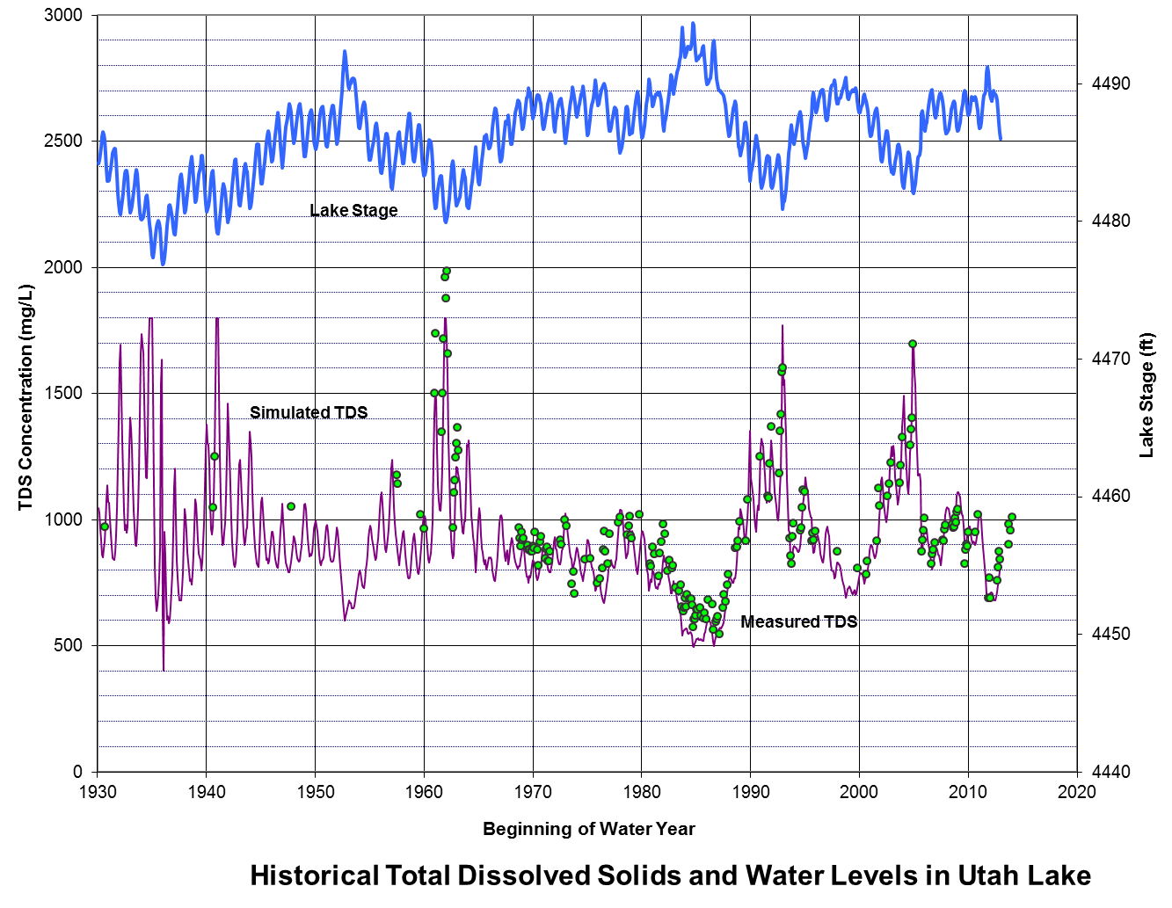
Utah Lake Nutrients
Empty elevation

Slide 16
Utah Lake Nutrients
Table 1. Utah Lake Inflows: Avg Salt and Water Quantities for 2009-2013.
______________________________________________________________________________________
I. INFLOW Flow | Percent of Inflowing S a l t s | % of Nutrients|
1. Surface af/yr % _ TDS Na Ca Mg K Cl HCO3 SO4 TP DN DP
a. Mtn Strms 287862. 52.0 24.3 12.9 42.5 28.3 14.5 10.0 39.6 19.6 7.0 14.5 4.2
b. WWTP 53126. 9.6 11.0 12.9 8.9 9.0 14.2 14.3 10.4 6.3 79. 54.7 85.5
c. Main L-other 77799. 14.1 17.3 12.4 16.6 24.1 15.2 9.8 22.1 27.8 7.6 17.5 6.2
d. Provo B-other 53232. 9.6 9.8 4.8 13.0 11.8 7.6 4.6 12.1 11.4 1.6 5.5 1.3
e. Gosh. B-other 23073. 4.2 14.0 24.1 3.2 10.1 17.5 23.7 3.4 14.3 1.6 2.3 1.5
1. Subtotal: 495092. 89.5 76.4 67.1 84.2 83.3 69.0 62.5 87.6 79.4 96.8 94.6 98.7
2. Fresh Grnd water
a. Main L-gw 31640. 5.7 3.3 1.9 3.9 5.2 3.4 1.7 5.2 2.7 0.4 1.8 0.3
b. Gosh. B-gw 11531. 2.1 3.0 3.4 2.1 3.9 4.7 3.8 2.3 2.9 0.1 0.7 0.1
2. Subtotal: 43171. 7.8 6.2 5.2 6.0 9.0 8.0 5.4 7.5 5.6 0.5 2.4 0.4
3. Thermal/Mineral GW
a. Main-min sprs 13957. 2.5 16.7 26.8 9.5 7.0 22.6 31.1 4.6 14.5 0.3 0.1 0.3
b. Gosh. B-m sprs 787. 0.1 0.3 0.6 0.1 0.1 0.4 0.5 0.1 0.4 0.0 0.0 0.0
3. Subtotal: 14744. 2.7 17.1 27.4 9.6 7.2 23.0 31.6 4.7 14.9 0.4 0.1 0.3
1,2& 3 subtot 553007. 100.0 99.7 99.8 99.8 99.5100.0 99.5 99.9 99.9 97.7 97.0 99.4
4. Precipitation
a. Main Lake 52884. b. Provo Bay 8633. c. Goshen Bay 31649.
4.Total Precip 93164. 0.3 0.2 0.2 0.5 0.1 0.5 0.1 0.1 2.3 3.0 0.6
100. 100. 100. 100. 100. 100. 100. 100. 100. 100. 100.
INFLOW TOTAL 646171.
II. Outflow.
1. Jordan River 336045.
2. Evaporation
a. Main Lake 218073. b. Provo Bay 32133. c. Goshen Bay 92602.
2. Subtotal 332808.
II. Outflow tot 668853.
Lake Storage -22682.
Net 646171.
TDS Na Ca Mg K Cl HCO3 SO4 TP DN DP
Ratio: salts out/salts in: 85. 108. 39. 107. 109. 110. 54. 110. 9.4 17.1 9.4
Approx. corrected
for lake volume change: 79. 101. 36. 100. 102. 103. 50. 103. 8.7 15.9 8.7

Slide 17
Utah Lake Nutrients
Table 2 . Utah Lake nutrient inflows and outflow—2009-2013.
Nutrient LoadIngs -- ton/Yr
TP DN DP
1. Surface Inflow af/yr % %
a. Mtn Strms 287862. 52.0 19 7 311 10
b. POTW 53126. 9.6 215 79 1174 196
c. Main L-other 77799. 14.1 21 8 375 14
d. Provo B-other 53232. 9. 4 1 118 3
e. Gosh. B-other 23073. 4.2 4 1 50 3
1. Subtotal: 495092. 89.5 264 97 2028 226
2. Fresh Grnd water
Subtotal: 43171. 7.8 1 51 1
3. Thermal/Mineral GW
Subtotal: 14744. 2.7 1 2 2
1,2& 3 subtot 553007. 100.0
4. Precipitation (rain and snow)
Total Precip 93164. 6 2.2 64 1
INFLOW TOTAL 646171. 272 2145 229
II. Outflow.
1. Jordan River 33604. 26 9.6 367 22
2. Evaporation 332808.
II. Outflow tot 668853.
Change in Storage -22682. TP % DN DP
Net 646171. 26 9.6 367 22
Lost--precipitated in the Lake 246 90.4 1778 207
_______________________________________________________
these values are under final review and may change slightly

Slide 18
Utah Lake Nutrients
Table 3. Nutrient Loadings to Utah Lake by water year, 2009 – 2013
________________________________________________________
Water Year Phos. tons/yr SRP tons/yr Nitrogen tons/yr
2009 277 232 2235
2010 257 219 1813
2011 327 267 2872
2012 247 211 1812
2013 252 216 1816
Average 272 229 2145

Slide 19
Utah Lake Nutrients
Utah Lake has natural high turbidity, Why?
In-lake chemical precipitation of calcium-carbonate-silica-phosphorus (largely clayey Marls) adds a natural, cloudy, mineral turbidity. (removes some 100,000 tons of dissolved minerals per yr--this results in an avg. of about 2” of bottom sediments per 100 yrs.)
Secchi Disk readings indexes light penetration.
(Typically at 2x to 3x the Secchi depth there isn’t enough light for appreciable algae growth—During the summer, Secchi depths in Utah Lake are usually less than 1 ft. (0.3 m)—indicating very high turbidity and very limited algae growth below 1 to 2 ft deep.)

Slide 20
Utah Lake Nutrients
Light limitation? Cont.
Avg. depth of Lake is about 9 ft. Frequent waves stir up and re-suspend the flocculent, precipitated sediments resulting in turbid, light-limiting, algae-growth conditions most of the time.
Ans: Overall Utah Lake algae growth is light-limited!

Slide 21
Utah Lake Nutrients
Might P & N possibly be limiting?
To answer this question, consider:
What are the actual in-lake conditions?
What do predictive Trophic Level models indicate?

Slide 22
Utah Lake Nutrients
1. What are the actual in-lake conditions?
Carlson Trophic State Index
(In-lake conditions—normally use the average of summer conditions)
Utah Lake in red:
Trophic Index | Chl a (ug/l) | P (ug/l) | Secchi Disk (m) | Trophic Class
<30—40 | 0—2.6 | 0—12 | >8—4 | Oligotrophic
40—50 | 2.6—20 | 12—24 | 4—2 | Mesotrophic
50—70 | 20—56 | 24—96 | 2—0.5 | Eutrophic
70—100+ | 56—155+ | 96—384+ | 0.5—<0.25 | Hyper-eutrophic
The hyper-eutrophic indication from Secchi Disk readings is a false indicator for Utah Lake since the low values are mainly due to mineral turbidity—not biological turbidity.

Slide 23
Utah Lake Nutrients
Conclusion:
Based on Lake data, the actual biological status of Utah Lake is “eutrophic”, not ultra hyper-eutrophic as predicted by models!

Slide 24
Utah Lake Nutrients
Trophic State Models
2. What do the predictive trophic level models tell us?
Larsen-Mercier Trophic State Model (developed by EPA scientists—improvement on the original Vollenweider Model.)
Model uses:
annual average concentration of phosphorus in inflowing waters.
lake residence time and depth.
Predicts the expected lake trophic level.
(but only if phosphorus is the controlling limiting factor in the lake)
The following chart also shows results for other lake evaluations done in about 1975.

Slide 25
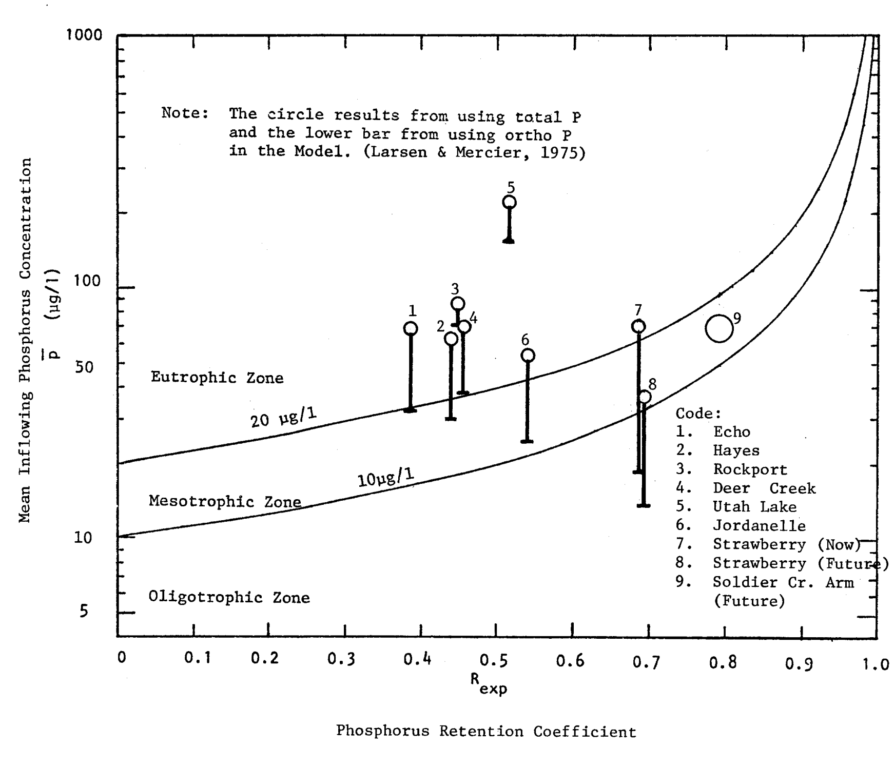
Utah Lake Nutrients
Utah Lake
634 ug/l
2008-2013
500
Utah Lake
~220 ug/l
1975
Hyper-Eutrophic Zone
Utah Lake
Eutrophic Zone
Strawberry Reservoir
Strawberry Res.
Mesotrophic
Oligotrophic
Predicted Trophic State based on the Larsen-Mercier Model

Slide 26
Utah Lake Nutrients
Is P limiting?
Ans: The L-M model predicts ultra-hyper eutrophic level but the actual condition is eutrophic.
Therefore: P is not limiting!
Might P be made limiting?
Remove POTW sources.
POTWs: About 80% of the Lakes P loading currently comes from them.
90-95% removal at POTWs would cost perhaps $300 million in construction costs and tens of millions in annual O&M costs.
Remove Nonpoint sources (NPS)—
As much as 25% of the remaining P might be removed with rigorous NPS controls.
Costs would be staggering—likely $100s of millions to get to a reliable 25% reduction in all other phosphorus loadings to the lake.
What is the L-M predicted result of such efforts?

Slide 27
Utah Lake Nutrients
Loading Utah Lake 2008-2013 634 ug/l
500
Utah Lake ~1975
with
-100% P removal @ POTWs
-Plus 25% all other P
Hyper-Eutrophic
Utah Lake
Strawberry Reservoir
Eutrophic Zone
Strawberry Res.
Mesotrophic
Oligotrophic
Predicted Trophic State based on the Larsen-Mercier Model

Slide 28
Utah Lake Nutrients
The New Big OH MY!
Atmospheric Precipitation: Rain, snow, dry deposition
Concentrations (tentative): (4 mons of data)
TP: about 150 ug/l
DN: about 2000 ug/l
And these don’t include dry deposition.
Utah lake:
Annual wet precipitation: 1 ft.yr
Lake depth: 4 to 9 ft over “normal wet and dry cycles.
Bomb Shell: Atmospheric Precipitation alone provides eutrophic loadings of nutrients to the Lake--No way can Utah Lake algae growth ever be limited by nutrient contol/removal!!!

Slide 29
Utah Lake Nutrients
Loading Utah Lake 2008-2013 634 ug/l
500
Utah Lake
Actual now
Utah Lake ~1975
With
-100% POTW removal
-Plus 25% all other
Hyper-Eutrophic
Utah Lake
Strawberry Reservoir
Eutrophic Zone
Strawberry Res.
Mesotrophic
Oligotrophic
Predicted Trophic State based on the Larsen-Mercier Model

Slide 30
Utah Lake Nutrients
Looking at the actual nutrient balance information—
Consider the actual phosphorus retention in the Lake (90%).
If the Lake were a “normal” phosphorus-limited lake then P retention would be about 50%--and the Jordan River would have ~300 ug/l rather than the ~50 ug/l found in the exiting River.
But its actual retention is about 90%--this means there are some rather dramatic, extraordinary, removal mechanisms occurring in the lake:
There are– Likely the main one is precipitation in the mineral precipitates (largely Marl clays) to the bottom sediments.
The “take- away”: Utah Lake is not a normal lake as to phosphorus—it has an almost unlimited capacity to trap P into the bottom sediments where it’s relatively unavailable to algae!
One might say that it’s doing a better job of P removal than any engineered Tertiary Treatment Plant could ever do—and it’s natural, organic, and Free!

Slide 31
Utah Lake Nutrients
Again—where is over 90% of the inflowing Phos. going?
Since the Lake has:
High pH
High oxygen levels
Abundant Calcium, Carbonate, Silica and Phosphorus.
Ans—To the sediments via mineral precipitation.
and
Precipitation of Marl & other minerals reduces available soluble phosphorus to relatively low levels—About 50 ug/l
But even then Phos. is not limiting algae growth most of the time; 50 ug/l would still make the lake more eutrophic than it actually is—
if it weren’t for Light limitation due to the lakes natural mineral turbidity!

Slide 32
Utah Lake Nutrients
Another piece of evidence—
Algal assay results (Don Porcella, USU, 1975)
Algae-growth assays on filtered Utah Lake water indicated that phosphorus was “bound” and only slowly became available.
–Much slower than algae could have used it (grown) otherwise.
I.e., when available P was largely used up by growing algae, it took relatively long times for more P to be released from the “bound” forms (tiny precipitated, flocculent particles).

Slide 33
Utah Lake Nutrients
Summary:
Overall, indications are that light-limitation limits Utah Lake to a natural eutrophic condition —if this were not the case the lake would be ultra-hyper eutrophic and of horrible quality. In fact, the lake would of likely disappeared (filled in) long ago and just be a swampy margin along an upward extension of the Jordan River.
Phosphorus loading to the lake is some 15 to 20 times larger than that needed to support its eutrophic level.
Most of the phosphorus is precipitated and bound in the lakes bottom sediments.
Nitrogen loading is also about 15+ times larger than eutrophic level.
Most nitrogen is likely de-nitrified to harmless nitrogen gas at the lake bottom-sediment interface.
It is extremely unlikely that removal of even all of the phosphorus coming from POTWs, plus 25% of the remaining loads, would significantly lower the lakes natural eutrophic level.
Phosphorus in the Jordan River at the lake outlet is quite low (about 50 ug/l) and determined largely by chemical equilibria with the precipitated sediments —and not determined by the amount of phosphorus coming into the lake.

Slide 34
Utah Lake Nutrients
Conclusion:
It is highly probable that the lake would be essentially the same quality as now, even if every nutrient source were reduced to the highest degree possible—at a cost of many hundreds of millions of dollars.
(We would simply be paying a gigantic price to remove the phosphorus that is now removed free by mother nature—to the bottom sediments)

Slide 35
Utah Lake Nutrients

