Slide 1
The trophic state of Utah Lake prior to European settlement
The question:
What was the trophic state of Utah Lake prior to European settlement and how has it changed as development proceeded?
Why ask the question:
If we could remove all sources of anthropogenic nutrients, we’ll know the baseline state of the lake.
Short of total removal, we may know what improvements can be reached.
The importance of N versus P
In no particular order:
Steve Nelson, BYU Dept. of Geological Sciences
Sam Rushforth, Rushforth Phycology

Slide 2
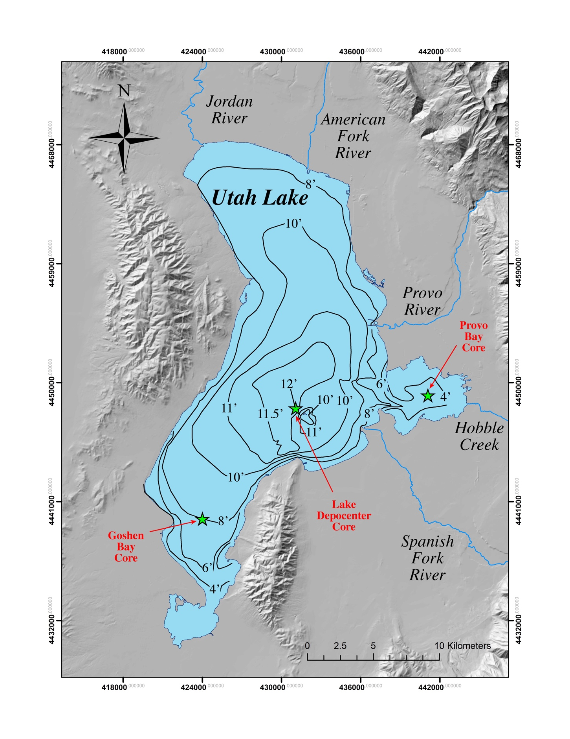
The trophic state of Utah Lake prior to European settlement
The proposed work:
Obtain 3 freeze cores
different lake environments—same story?
near established sondes
Establish a chronology for each
²¹⁰Pb
δ¹⁵N
Develop diatom biostratigraphy
trophic state
N metabolism
Diatom productivity thru time
Balance of emergent vegetations vs. algal biomass in sediment

Slide 3
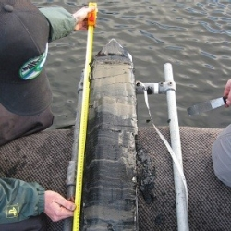
The trophic state of Utah Lake prior to European settlement
best possible preservation of primary stratigraphy & pore water
share material with Greg Carling—pore water/sediment P?

Slide 4
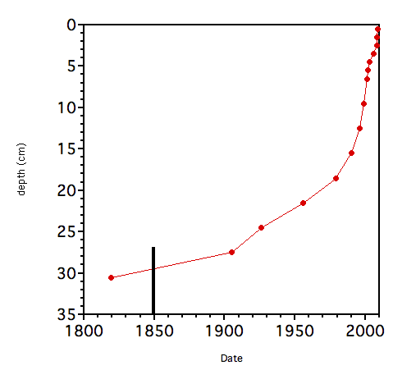
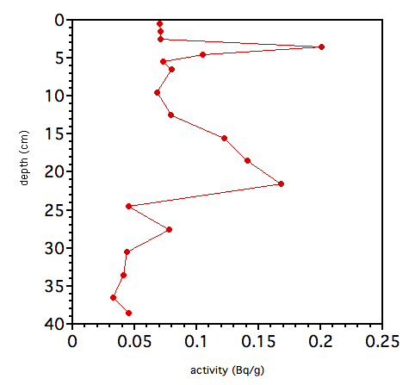
The trophic state of Utah Lake prior to European settlement
settlement
²¹⁰Pb

Slide 5
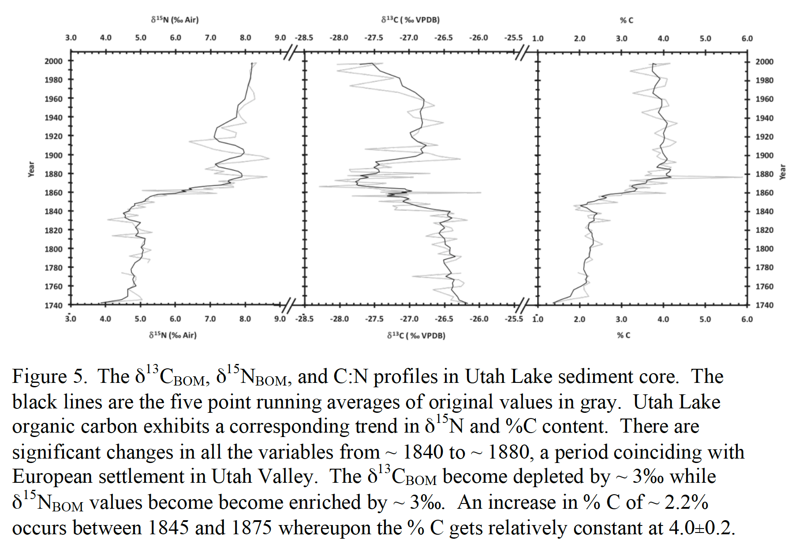
The trophic state of Utah Lake prior to European settlement
N from settlement
more BOM
stable isotopes act as a check on chronology
from ²¹⁰Pb chronology
²¹⁰Pb

Slide 6
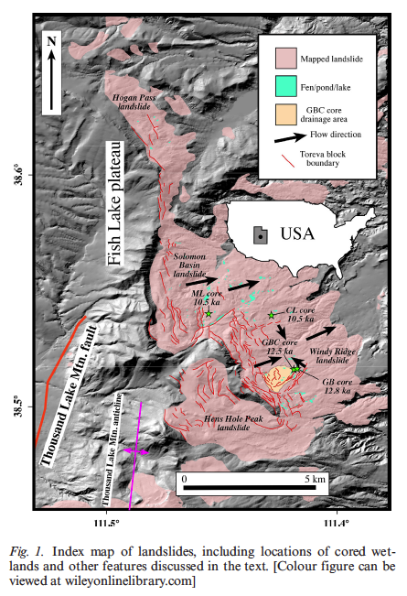
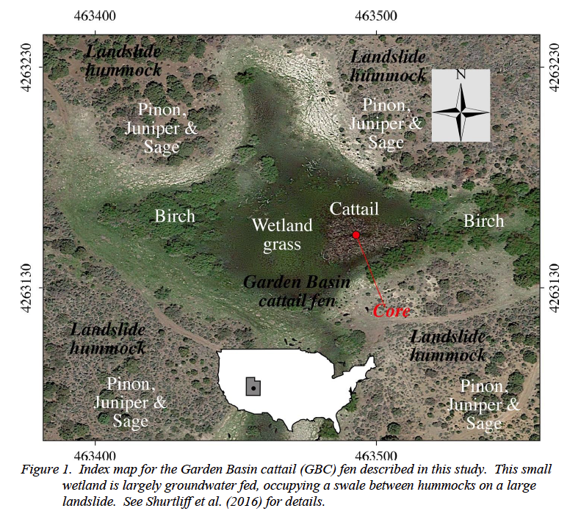
The trophic state of Utah Lake prior to European settlement

Slide 7
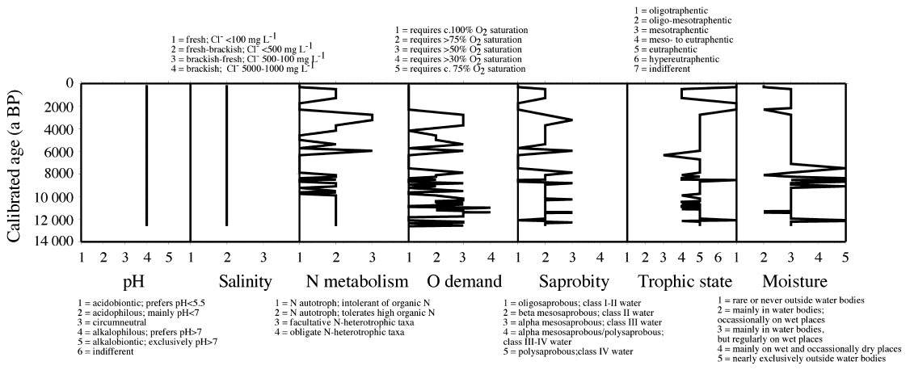
The trophic state of Utah Lake prior to European settlement

Slide 8
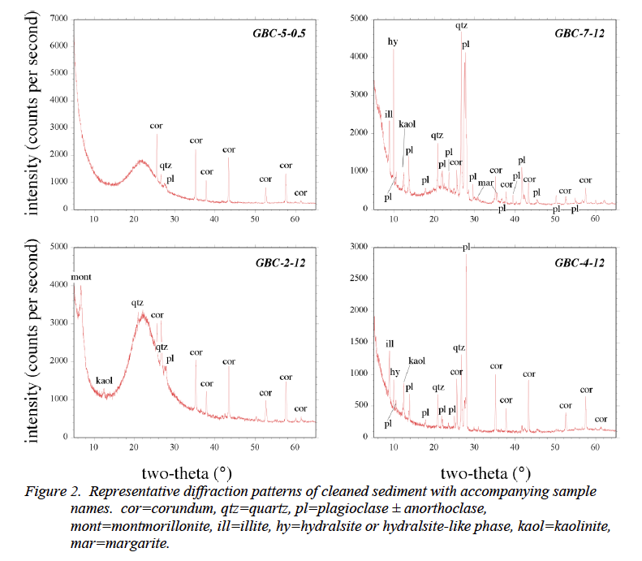
The trophic state of Utah Lake prior to European settlement
low-hanging fruit

Slide 9
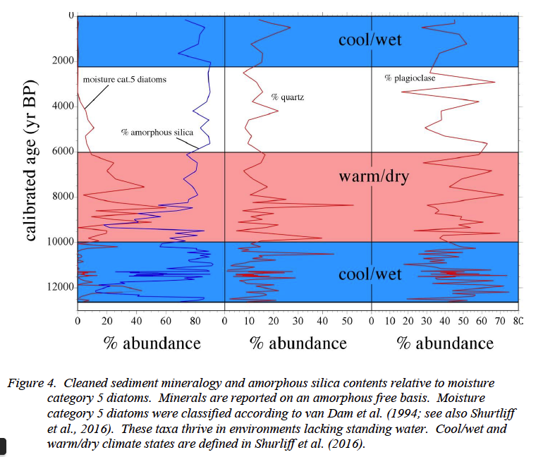
The trophic state of Utah Lake prior to European settlement
In the fen, diatom productivity was driven by water. In Utah Lake it should be driven by nutrients

Slide 10
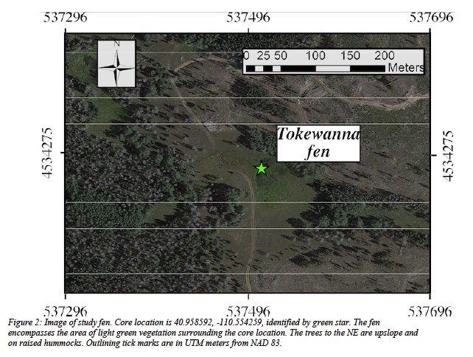
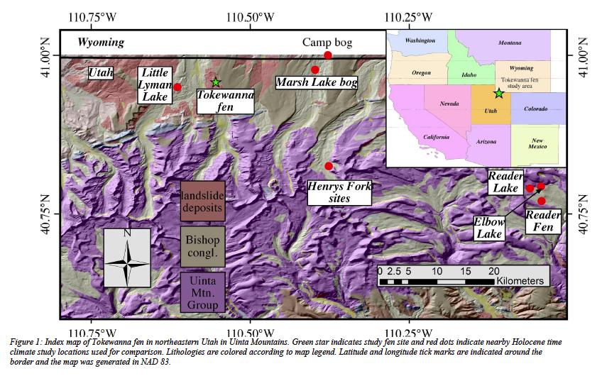
The trophic state of Utah Lake prior to European settlement

Slide 11
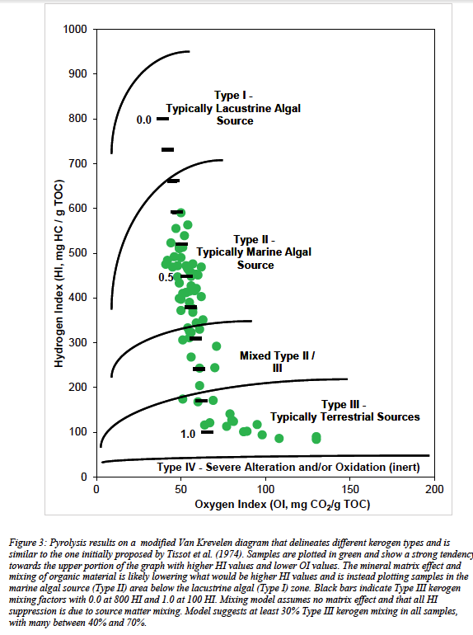
The trophic state of Utah Lake prior to European settlement
Pyrolysis method designed for oil/gas industry, RockEval detects OM from emergent vegetation versus algae
Should provide such a record from Provo Bay
Has the algal component increased since settlement?
Also provides TOC and TIC

Slide 12
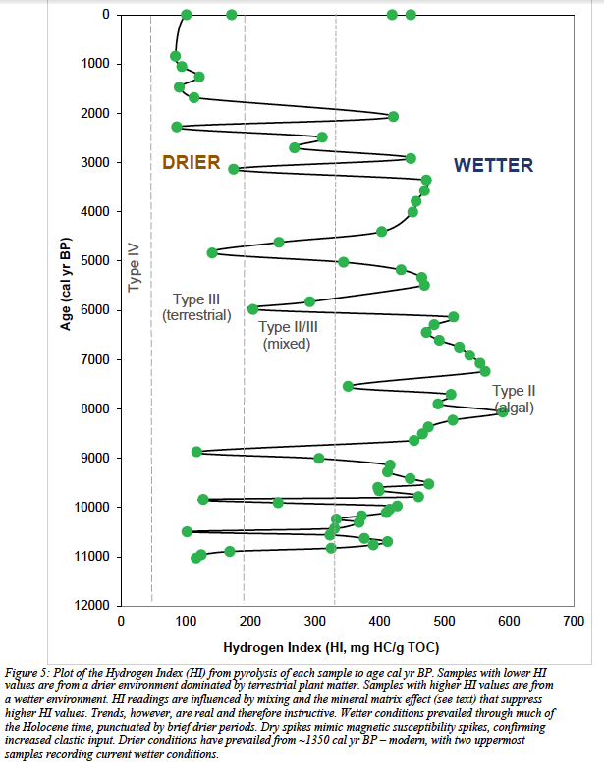
The trophic state of Utah Lake prior to European settlement
Pyrolysis method designed for oil/gas industry, RockEval detects OM from emergent vegetation versus algae
Should provide such a record from Provo Bay
Has the algal component increased since settlement?
Also provides TOC and TIC
emergent vegetation
more algae

Slide 13
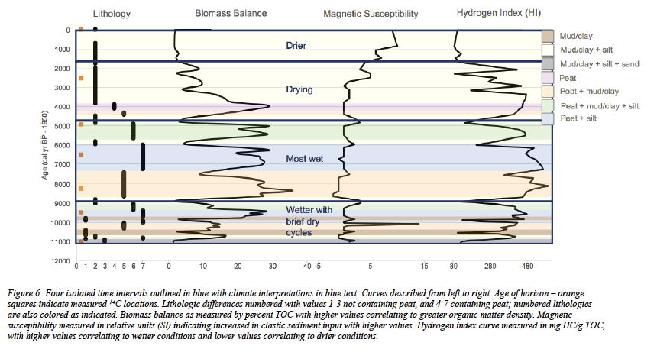
The trophic state of Utah Lake prior to European settlement
Total Organic Carbon

Slide 14
The trophic state of Utah Lake prior to European settlement
Summary:
Core in multiple locations to see if they tell the same story
co-locate with sondes
Establish a chronology
need to know “when”
Interrogate the diatoms to look for changes in trophic state through time
maximum possible improvement
incremental improvement
Look at diatom productivity through time
does productivity relate to settlement?
Look at the balance of emergent vegetation vs. algae in the organic fraction of sediment
does the algal fraction increase due to settlement?

