Slide 1
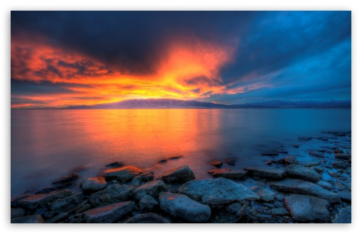
Richard Mickelsen Provo City
Utah Lake Education ½-Day
3/30/17

Slide 2
POTW We Clean The Water

Slide 3
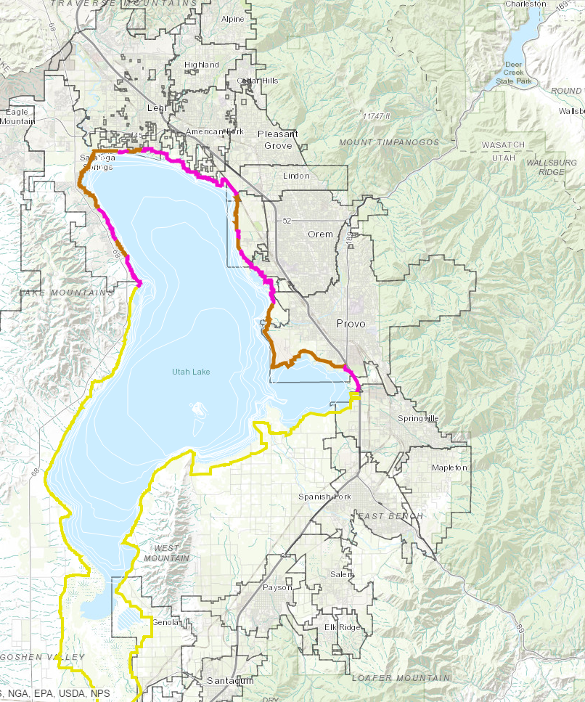
http://www.mountainland.org/utahlaketrailplan

Slide 4
American Fork
Facility
1953
http://www.mountainland.org/utahlaketrailplan

Slide 5
American Fork
Facility
1953
Springville
Facility
1955
http://www.mountainland.org/utahlaketrailplan

Slide 6
Lehi
Facility
1958
American Fork
Facility
1953
Pleasant Grove
Facility
1958
Orem
Facility
1958
Provo Facility
1957
Springville
Facility
1955
Spanish Fork
Facility
http://www.mountainland.org/utahlaketrailplan

Slide 7
EPA
Water Quality
Board
DWQ
POTW
CWA 1972

Slide 8
Timpanogos
Facility
Orem
Plant
Provo Facility
Springville
Facility
Spanish Fork
Facility
Payson Facility
Salem
Ponds
Santaquin Facility
http://www.mountainland.org/utahlaketrailplan

Slide 9
VOLUME
POTW’s = 70,000,000 Gallons / Day

Slide 10
VOLUME
Utah Lake Volume = 870,000 acre feet

Slide 11
VOLUME
Year
POTW ~ 10% Utah Lake

Slide 12
VOLUME
POTW’s = 70,000,000 Gallons / Day
Utah Lake Volume = 870,000 acre feet
Year
POTW ~ 10% Utah Lake

Slide 13
Provo’s Cleaning Wastewater Numbers
Analytes of Concern | Raw | Limits | Provo | Units | Removal (%)
BOD | 152 | 25 | < 2 | mg/L | 98.7
TSS | 186 | 25 | < 2 | mg/L | 98.9
E. Coli | > 2420 | 126 | 3 | No./100 mL | 99.9
Ammonia | 26.3 | 3 | < 0.02 | mg/L | 99.2
WET | - | Pass | Pass | Pass
Oil & Grease |  | 10 | < 10 | mg/L
pH | 7.8 | 8 | 7 .2 | S.U.
DO | 4.9 | 9 | 8.4 | mg/L
Metals | - | List | < MDL
Organic Toxics | - | List | < MDL
Other
TDS | - | - | 600 | mg/L
Nutrients
Phosphate | 4.4 | 1 | 2.7 | mg/L | 38.6
Nitrogen | 32 | - | 25 | mg/L | 21.9

Slide 14
Provo’s Cleaning Wastewater Numbers
Analytes of Concern | Raw | Limits | Provo | Units | Removal (%)
BOD | 152 | 25 | < 2 | mg/L | 98.7
TSS | 186 | 25 | < 2 | mg/L | 98.9
E. Coli | > 2420 | 126 | 3 | No./100 mL | 99.9
Ammonia | 26.3 | 3 | < 0.02 | mg/L | 99.2
WET | - | Pass | Pass | Pass
Oil & Grease | 20.7 | 10 | < 10 | mg/L
pH | 7.8 | 8 | 7 .2 | S.U.
DO | 4.9 | 9 | 8.4 | mg/L
Metals | - | List | <
Organic Toxics | - | List | <
Other
TDS | - | - | 600 | mg/L
Nutrients
Phosphate | 4.4 | 1 | 2.7 | mg/L | 38.6
Nitrogen | 32 | - | 25 | mg/L | 21.9

Slide 15
Technology Base Phosphorus Effluent Limit (TBPEL)
See if it improves (Adaptive)

Slide 16
Technology Base Phosphorus Effluent Limit (TBPEL)
See if it improves (Adaptive)
Time to do the science

Slide 17
Technology Base Phosphorus Effluent Limit (TBPEL)
See if it improves (Adaptive)
Time to do the science
Litigation prevention

Slide 18
Technology Base Phosphorus Effluent Limit (TBPEL)
See if it improves (Adaptive)
Time to do the science
Litigation prevention
Do Something. . . Hold the line

Slide 19
DWQ Tier Study
Tier | P (mg/L) | N (mg/L) | Projected State of Utah Total Capital Cost ($ Millions) | Projected State of Utah Total O&M Cost ($ Millions)
3 | 4.4 | 32 | - | -
2 | 1 | - | 24 | 4.4
2N | 1 | 20 | 142 | 4.4
1 | 0.1 | - | 818 | 14.4
1N | 0.1 | 10 | 1,043 | 16.3
Advancement of Cost Engineering (AACE) International Class 4 estimate with -30% / +50%

Slide 20
Water Quality
Site Specific
TMDL
Attainable

Slide 21
POTW
Timpanogos
Facility
Orem
Plant
Run Off
Provo Facility
Springville
Facility
Agriculture
Spanish Fork
Facility
Payson Facility
Salem
Ponds
Groundwater
Santaquin Facility
http://www.mountainland.org/utahlaketrailplan

Slide 22
POTW
Timpanogos
Facility
Orem
Plant
Run Off
Phosphorus
Recycling
Provo Facility
Springville
Facility
Agriculture
Spanish Fork
Facility
Payson Facility
Salem
Ponds
Groundwater
Santaquin Facility
http://www.mountainland.org/utahlaketrailplan

Slide 23
POTW
Timpanogos
Facility
Orem
Plant
Run Off
Phosphorus
Recycling
Provo Facility
Springville
Facility
Agriculture
Air Deposition
Spanish Fork
Facility
Payson Facility
Salem
Ponds
Groundwater
Santaquin Facility
http://www.mountainland.org/utahlaketrailplan

Slide 24
POTW
Timpanogos
Facility
Orem
Plant
Run Off
Storm Water
Phosphorus
Recycling
Provo Facility
Springville
Facility
Agriculture
Air Deposition
Spanish Fork
Facility
Payson Facility
Salem
Ponds
Groundwater
Santaquin Facility
http://www.mountainland.org/utahlaketrailplan

Slide 25
POTW
Timpanogos
Facility
Orem
Plant
Run Off
Storm Water
Phosphorus
Recycling
Provo Facility
Springville
Facility
Agriculture
Air Deposition
Spanish Fork
Facility
Payson Facility
Salem
Ponds
Groundwater
Santaquin Facility
http://www.mountainland.org/utahlaketrailplan

Slide 26
POTW
Timpanogos
Facility
Orem
Plant
Run Off
Storm Water
Phosphorus
Recycling
Provo Facility
Springville
Facility
Agriculture
Air Deposition
Spanish Fork
Facility
Payson Facility
Salem
Ponds
Groundwater
Santaquin Facility
http://www.mountainland.org/utahlaketrailplan

Slide 27
POTW
Timpanogos
Facility
Orem
Plant
Run Off
Storm Water
Phosphorus
Recycling
Provo Facility
Springville
Facility
Agriculture
Air Deposition
Spanish Fork
Facility
Payson Facility
Salem
Ponds
Groundwater
Santaquin Facility
http://www.mountainland.org/utahlaketrailplan

Slide 28
Jordan River
POTW
Timpanogos
Facility
Orem
Plant
Run Off
Storm Water
Phosphorus
Recycling
Provo Facility
Carp
Springville
Facility
Agriculture
Air Deposition
Spanish Fork
Facility
Payson Facility
Salem
Ponds
Groundwater
Santaquin Facility
http://www.mountainland.org/utahlaketrailplan

Slide 29
Jordan River
POTW
Timpanogos
Facility
Orem
Plant
Run Off
Storm Water
Phosphorus
Recycling
Provo Facility
Carp
Springville
Facility
Agriculture
Air Deposition
Spanish Fork
Facility
Payson Facility
Salem
Ponds
Groundwater
Santaquin Facility
http://www.mountainland.org/utahlaketrailplan

Slide 30
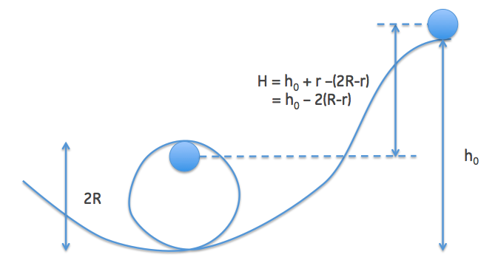
Loop-the-Loop Question
$$mg=ma_{c}=m\frac{V^{2}}{R}$$
$$h_{o}= 5/2R$$

