Slide 1

UTAH’s Approach for developing Nutrient Standards
Utah Division of Water Quality
Notes:
This presentation is provided to our local, state and federal partners to get your feedback and answer questions.
The presentation will provide an overview of:
What water quality standards are
Our concerns about excess nutrients
How nutrient standards will be developed, and
How this process will allow Utah to better protect and more quickly improve water quality

Slide 2
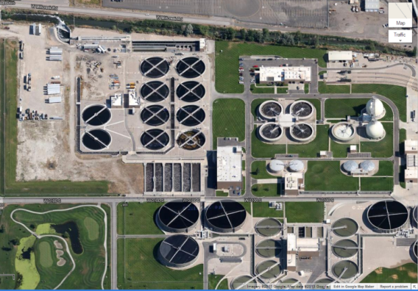
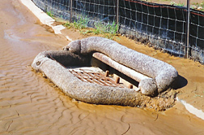
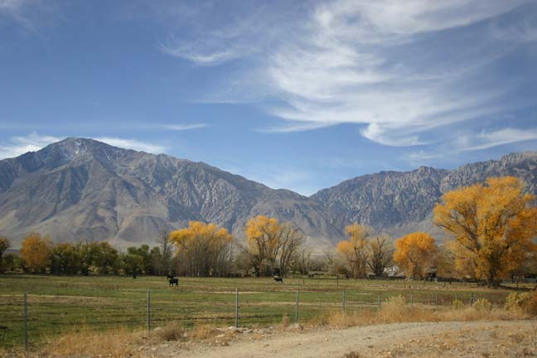
Nutrient Core Team
Subcommittees
POTWs
Stormwater
Nonpoint Sources
nutrients.utah.gov
Notes:
The Division of Water Quality has put together a Nutrient Core Team, who are tasked with defining the approach for developing and implementing nutrient criteria with the assistance of three key stakeholder groups, Publicly Owned Treatment Works, aka sewage treatment plants, Stormwater experts on urban development and construction activities, and Nonpoint Sources. This includes primarily agricultural activities, transportation, septic systems, and airborne sources. Much more information about the Nutrient Core Team, meetings, and other information about nutrients are on the website “nutrients.utah.gov”.

Slide 3
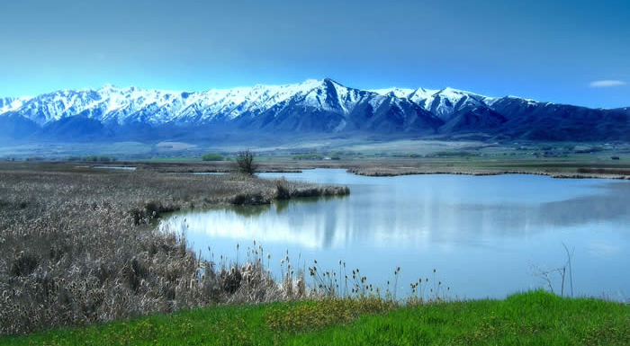
Mission Statement
Protect, maintain and enhance the quality of Utah's waters… while giving reasonable consideration to the economic impact.
Notes:
DWQ’s mission is to “protect, maintain and enhance the quality of Utah’s waters… while giving reasonable consideration to the economic impact.”
Water quality standards are a measure of what “good” water quality is versus “bad”.

Slide 4




Why Do We Need Standards?
To protect the water’s beneficial uses
  Drinking
  Recreation
  Fisheries
  Agriculture
Notes:
Water quality standards are set to protect our water’s beneficial uses: for drinking, recreation, fisheries and agriculture. Current standards include things like maximum concentrations of toxic chemicals and other pollutants that impair the beneficial use of water as well as minimum levels of oxygen needed to protect fisheries. In some cases, a particular stream or lake’s uses need to be re-evaluated and modified through scientific analysis, public review, and approval from the Water Quality Board and EPA.

Slide 5
Standards and Beneficial Uses
 | 1C | 2A | 2B | 3A | 3B | 4
Dissolved Oxygen (mg/l) |  |  |  | > 4.0 > 8.0 (early life stages) | > 3.0 > 5.0 (early life stages)
Methoxychlor (ug/l) | 40 |  |  | 0.03 | 0.03
E. Coli (cfu/100 ml) | < 206 | < 126 | < 206
Temperature |  |  |  | < 20 ºC | < 27 ºC
pH | 6.5 – 9.0 | 6.5 – 9.0 | 6.5 – 9.0 | 6.5 – 9.0 | 6.5 – 9.0 | 6.5 – 9.0
Total Dissolved Solids (mg/l) |  |  |  |  |  | <1,200
Nitrate (mg/l) | < 10 | < 4 | < 4 | < 4
Lead (mg/l) | 0.015 |  |  | 2.5 | 2.5 | 0.1
Notes:
Water quality standards are set for specific pollutants at the level they’re protective of a specific beneficial use. For example the dissolved oxygen standard is more stringent for cold water fisheries than warm water since trout are more sensitive to low levels than bass and catfish.

Slide 6
Excess Nutrient Problem
Too much nitrogen and phosphorus in water results in too much algae growth
Too much algae in streams and lakes* can result in:
  Bad taste and odors in drinking water
  Nuisance algae blooms and swimmer’s rash
  Impaired fisheries
  Sick livestock
Notes:
Nutrients, specifically nitrogen and phosphorus, are a growing problem for water quality in Utah.
Excess nutrients result in:
bad tasting water,
smelly algae blooms,
low dissolved oxygen that hurt or kill fish, and
poor health of livestock and pets.
I emphasize the word “excess” since some nutrients are needed to support the food web that fish rely on but the levels we’ve seen and are concerned about are significantly higher.
*Caveat that these concerns with algae do not apply to the Great Salt Lake as it’s a unique saline ecosystem currently undergoing intensive study to determine appropriate standards.

Slide 7
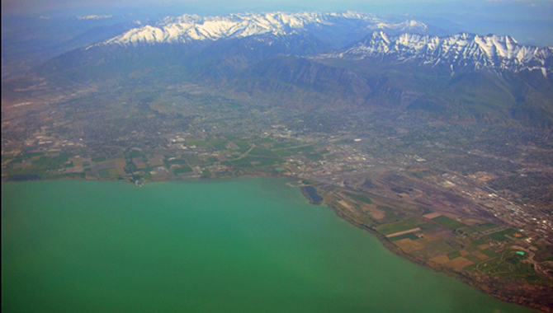
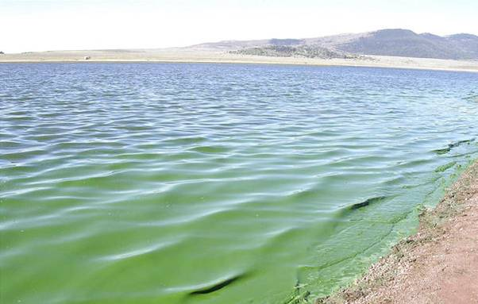
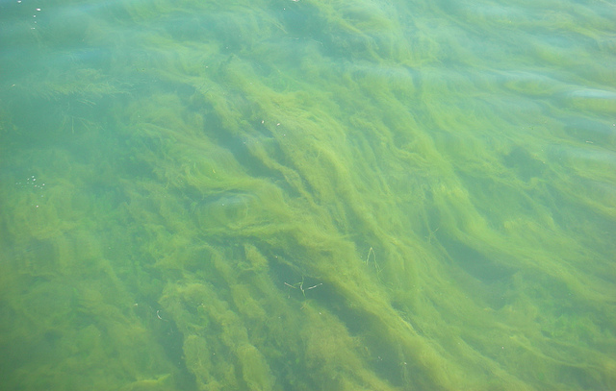
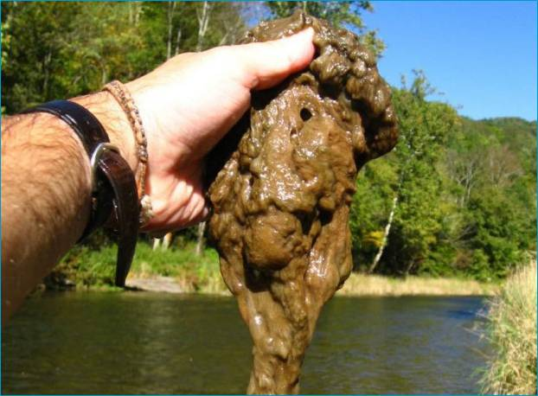
Utah Lake
Matt Warner Reservoir
Cladophora
Didymo
Notes:
A visible example of excess nutrients here in Utah are algae blooms in our lakes and streams, usually occurring in the summer as water temperatures rise and sunlight is plentiful.

Slide 8
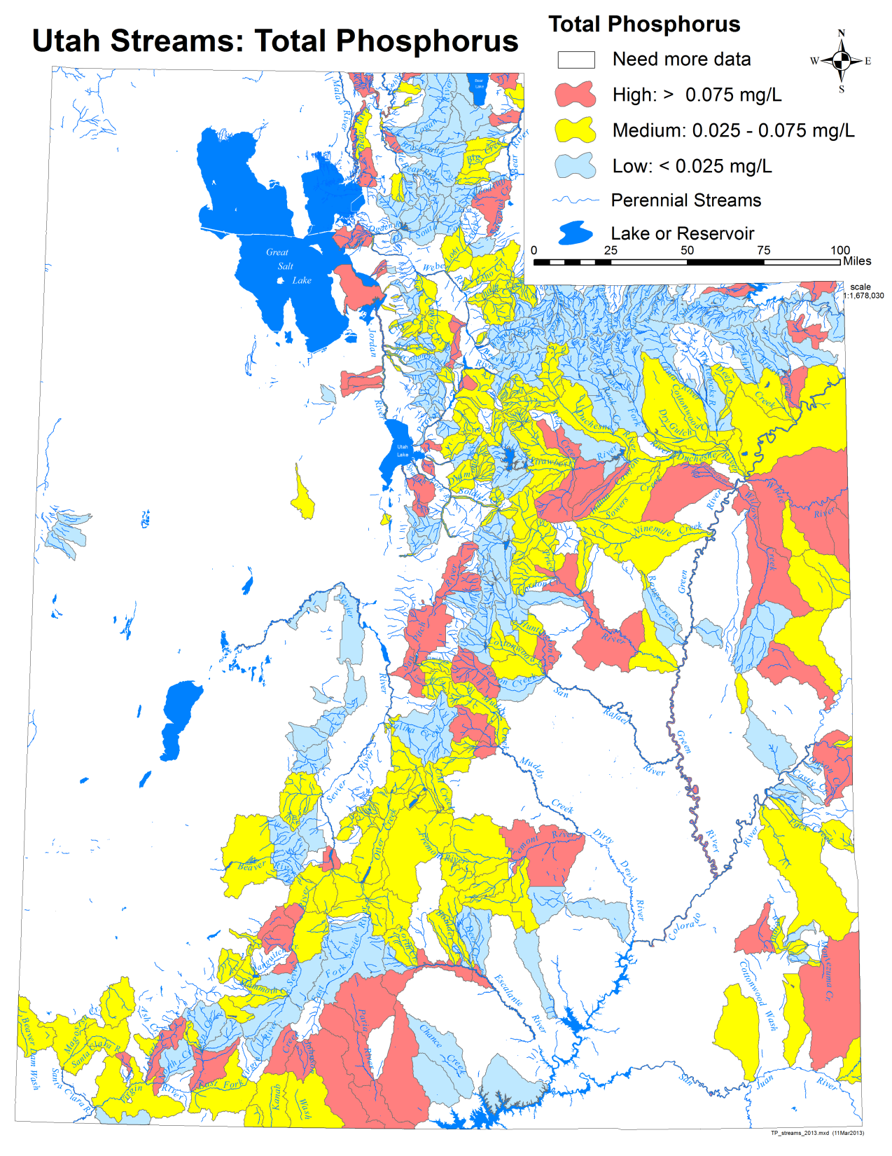
Red = High (> 75 ppb)
Yellow = Moderate (25-75 ppb)
Blue = Low (< 25 ppb)
Notes:
This map shows that the excess nutrient problem isn’t limited to any particular area of the state. The red areas are the drainages or watersheds of streams with high phosphorus concentrations.

Slide 9
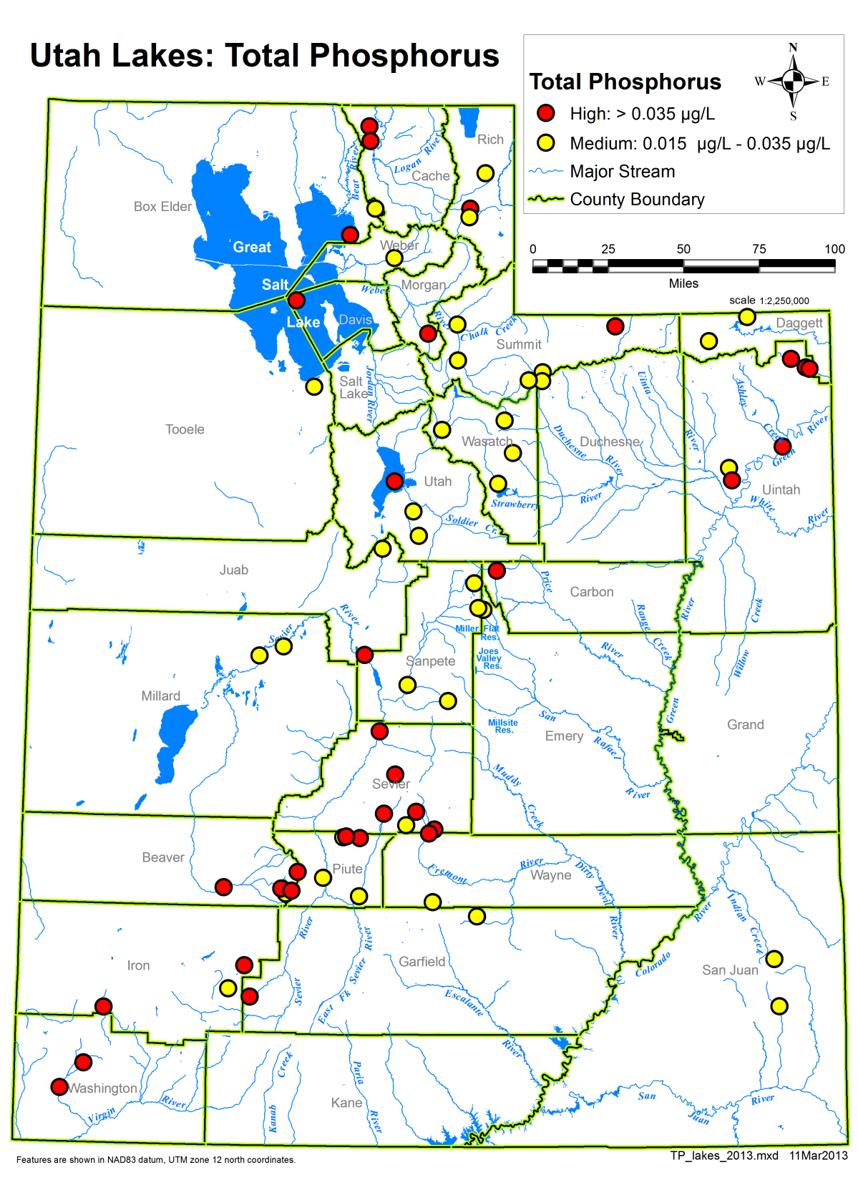
Red = High (> 35 ppb)
Yellow = Moderate (15-35 ppb)
Notes:
The same widespread pattern is shown here for our lakes and reservoirs.

Slide 10
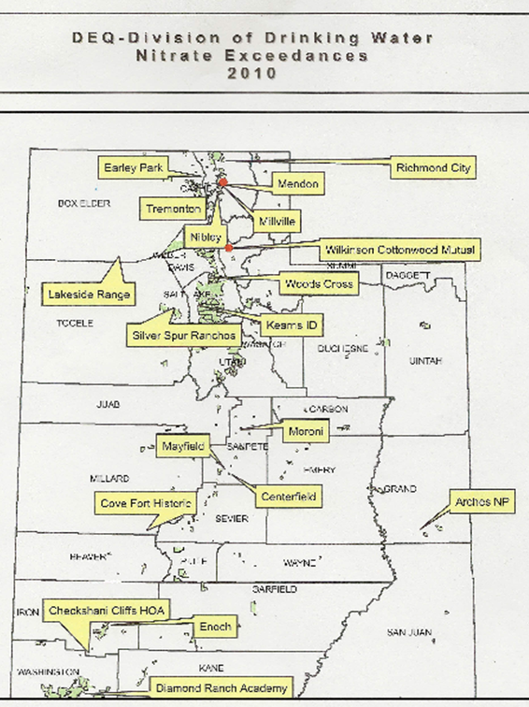
Elevated Nitrate Levels in Utah’s Public Water Systems
Notes:
Nitrate (a form of nitrogen) is also a concern, particularly for drinking water. In the last 5 years two drinking water wells in Utah had to be abandoned due to nitrate contamination.
Human sources include fertilizers, septic systems, leaking sewage lines and manure. In some parts of the state there are high levels of nitrate already in the groundwater due to natural sources making the addition of human caused sources a particular concern.

Slide 11

Nitrate Concerns
Nitrate contamination lasts for decades and can’t be filtered out
Toxic to infants (>10 mg/L)
Drinking water wells are susceptible to contamination, protection is key
Notes:
Nitrate easily moves through the soil into groundwater where it lasts for decades, can’t be filtered out, and is toxic to infants. The key is protecting groundwater from contamination in the first place.

Slide 12
Goals for Setting Nutrient Standards
  Effective
  Science-based
  Reasonable Costs and Benefits
  Consistent and Fair
  Shared Responsibility
Notes:
The goal for setting nutrient standards is foremost to be effective at protecting our water’s beneficial uses. In order to be effective nutrient standards must be based on solid science, reasonable, and fair with shared responsibility among all members of society.

Slide 13
Effective
Strategically target limited resources
Establish attainable goals
Immediately protects high quality headwaters
Focuses on nutrient related problems
Reduces nutrient discharges from POTWs
Provides increased funding for NPS projects
Engages stakeholders to implement solutions
Notes:
The expected results of this approach to addressing the excess nutrient problem is we’ll be able to:
More effectively target limited resources,
Establish attainable goals
Immediately protect our highest quality waters,
Focus on nutrient related problems,
Reduce point source nutrient loads,
Provide increased funding for NPS best management practices, and
Engage stakeholders, that’s you, to lend a hand in finding effective solutions to the excess nutrient problem.

Slide 14
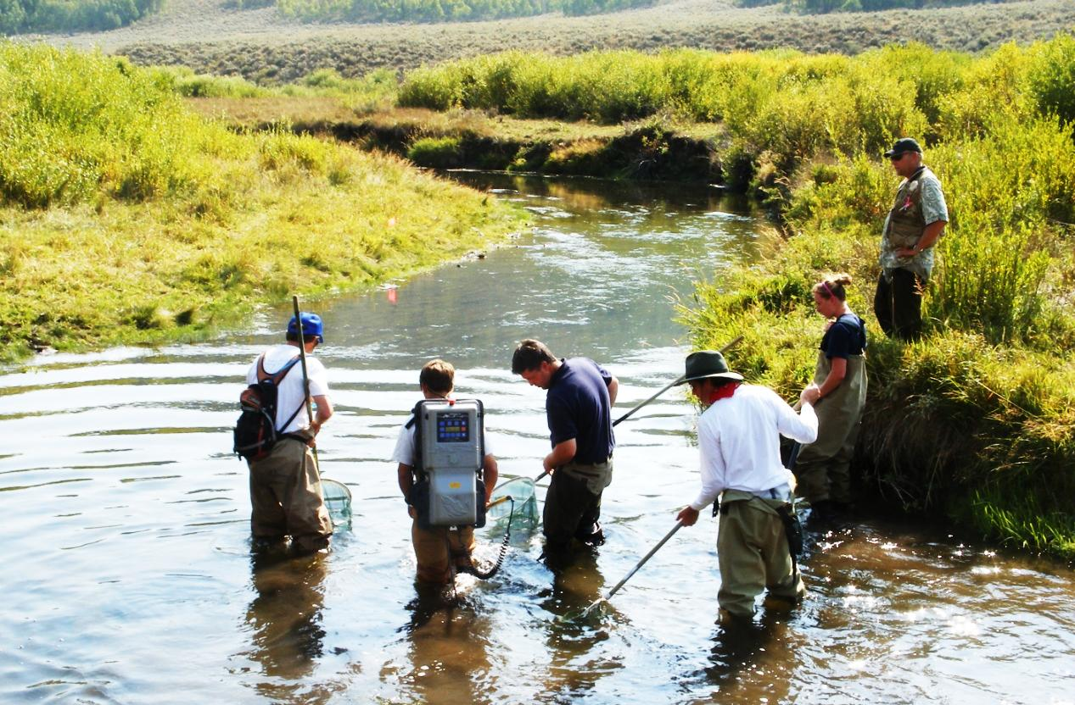
Science-Based
Notes:
Scientists have been collecting, analyzing and reporting water quality data in Utah for over 30 years. These measurements include the biological, physical and chemical conditions of our water.

Slide 15
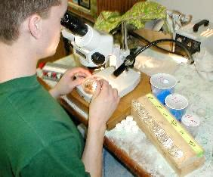
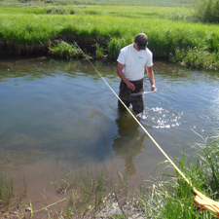
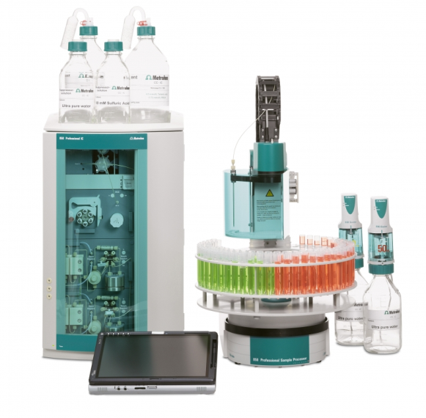
Water Quality Studies
Biological
Physical
Chemical
Notes:
Measuring the biological, chemical and physical condition of water entails both laboratory and field work by a variety of professionals. All of this information is then compiled and analyzed by water quality scientists to determine the health of our streams and lakes.

Slide 16
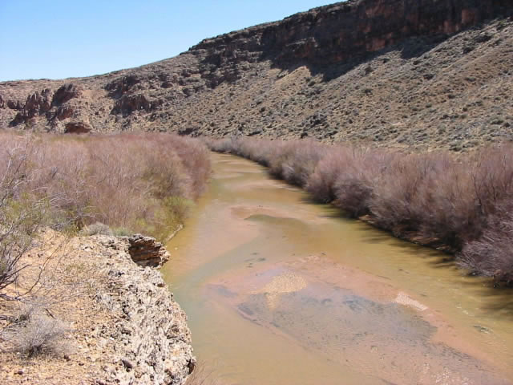
Reasonable
Will Account for the
Diversity of Utah’s Waters
Notes:
In order to reasonable and realistic nutrient standards must account for the wide diversity of waterbodies found in Utah, from high alpine streams, to valley bottom rivers and desert creeks. One size doesn’t fit all.

Slide 17


Consistent and Fair
Establish a Level Playing Field
Provide Financial and Technical Assistance
Maintain Open Communication
Encourage Voluntary Action
Notes:
We believe that every effort should be made to seek solutions collaboratively, but there will be situations where these efforts are not enough. For point sources this may mean more stringent permit limits, plant upgrades and permit compliance schedules. For NPS, this may mean requiring those who are not already doing their part to step up and do their part. In these situations it’s important to be consistent and fair, everyone should be given the same opportunities to receive assistance, discuss expectations, and voluntarily do their part while being held to the same standards as everyone else.

Slide 18
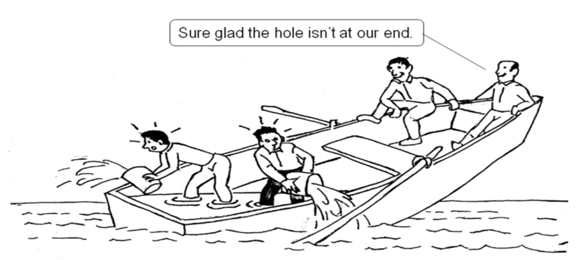
Shared Responsibility
Early Stakeholder Involvement
Use Best Management Practices and Technology to achieve goals
Provide Financial and Technical Assistance
Notes:
There must also be buy-in and adoption among stakeholders of the goals, purpose and means of achieving nutrient standards. This presentation is a part of that process, to get your feedback and questions. There will also be future opportunities for you to weigh in on where, when and how nutrient standards are established.
Since nutrient pollution comes from and affects all segments of society including urban and rural, homeowners and businesses, everyone shares in the responsibility for controlling it. There are many practices and technologies designed to help each of these segments of society do their part in reducing nutrient pollution and its in society’s best interest to help those who either don’t know how or can’t afford to put these practices into place.

Slide 19
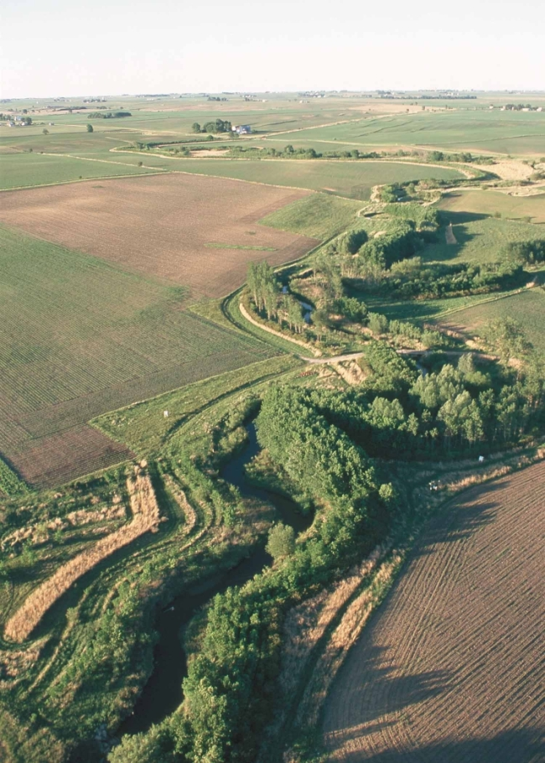
Financial Assistance
Voluntary Prior to TMDL
Required After TMDL Established
Environmental Stewardship Certification Program (SB-57)
Interim Legislative Subcommittee Study
Cost Share Funding Range (Proposed)
70% to 90%
Notes:
Recognizing that nutrient control is less expensive for nonpoint sources than it is for wastewater treatment plants on a pound per pound basis, DWQ and its partners are supporting an initiative to increase the amount of cost share available for implementing best management practices to improve and protect water quality. Best management practices are often a win-win for both the producer and the environment. However, with this opportunity comes greater responsibility and an obligation for nonpoint sources to step up and help reduce nutrient loading to the environment, our goal is to ensure the costs are commensurate with the water quality benefit.

Slide 20
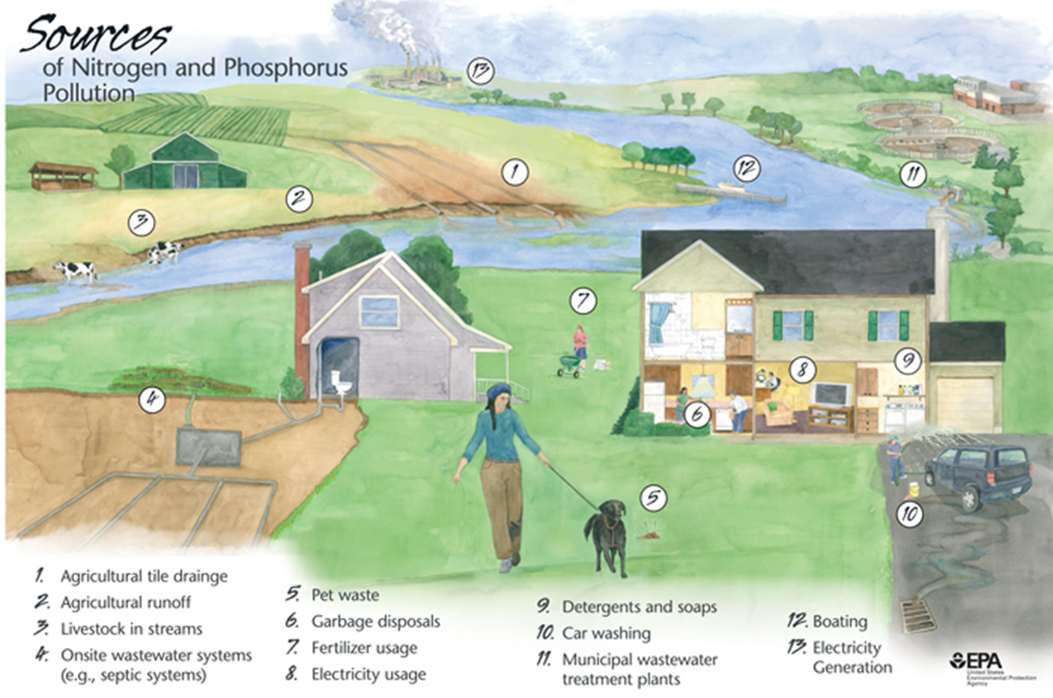
Everyone Has a Role
Notes:
To recap, there’s no single fix or sole responsible party for the excess nutrient problem. As this picture shows all segments of society are responsible for its cause and its solution. From the homeowner in the city to the farmer in the country, from the land developer to the wastewater treatment plant manager, we all have a role to play in protecting and improving water quality for current and future generations.

Slide 21
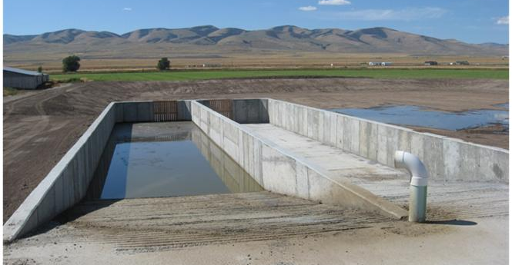
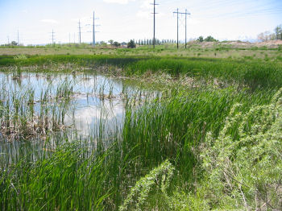

BMPs for Controlling Nutrients
Manure Management
Stormwater Treatment
Wastewater Treatment
Notes:
It’s important to recognize current efforts to control nutrient pollution. We’re not starting from scratch. There are many examples throughout Utah of successful efforts to no only control nutrient pollution but manage them as a valuable resource. As our population grows over the next 20 years to almost 4 million people, a 36% increase, these efforts will need to be sustained and expanded. Nutrient standards are important to ensure that our State’s success does not degrade its future.

Slide 22
ADAPTIVE MANAGEMENT APPROACH
Headwaters
Establish Criteria
Point Source – Technology Standard or TMDL Load Allocation
TMDL/Habitat Impaired Waters
Adaptive Management
Great Salt Lake
Awaiting Science
TMDL If Needed
Waters Definitely Impaired by Nutrients
Study to Determine Criteria
Intermediate Quality Waters
Waters That May Be Impacted by Nutrients
Waters That Are Not Impacted by Nutrients
Establish Criteria
- General Indicators Compared to Existing Water Quality
- Includes Numeric, Structural, Biological and Habitat Indicators
Notes:
The goal of Utah’s approach for setting nutrient standards is protecting the water’s beneficial use. Given the wide diversity of streams and lakes throughout Utah the level of nutrients protective of beneficial uses in one type of stream will be different than in another. For example, the allowable level of nutrients in a large river such as the Green is likely higher than in a small mountain stream due to its different characteristics.
If a waterbody is supporting all of its beneficial uses, we can assume that current nutrient concentrations are protective and set the standard there. If beneficial uses are impaired the focus will be on reducing nutrients by implementing best management practices until uses are supported and then set nutrient standards at that point.
The best part of this adaptive management approach is that we start on the solution up front rather than spend valuable time and resources debating over what’s the “right number” before we start implementing best management practices. We will let the waterbody show us. For this approach to succeed we must all commit to doing our part in reducing nutrient loads, making sure others do their part, and help measure our progress towards achieving water quality goals.

Slide 23
Steps Forward
May 2013 - Outline approach and path forward with Lt. Governor and interim legislative committee leaders
Prepare for legislation in the 2014 session.
Rulemaking after 2014 legislative session to establish headwater standards.
Continue to develop the details of the implementation strategy.
Notes:
Senate Bill 216 - Water Quality Task Force was proposed but not passed in the last legislative session. This bill would have developed a task force to study NPS pollution related to nutrients in Utah. It is now in interim study with the Natural Resources, Agriculture and Environment Interim Committee and will be discussed in more detail when the committee meets in the Fall. Planning for the legislative presentations will begin in May with a meeting with the Lt. Governor and the Committee’s co-chairs.

Slide 24
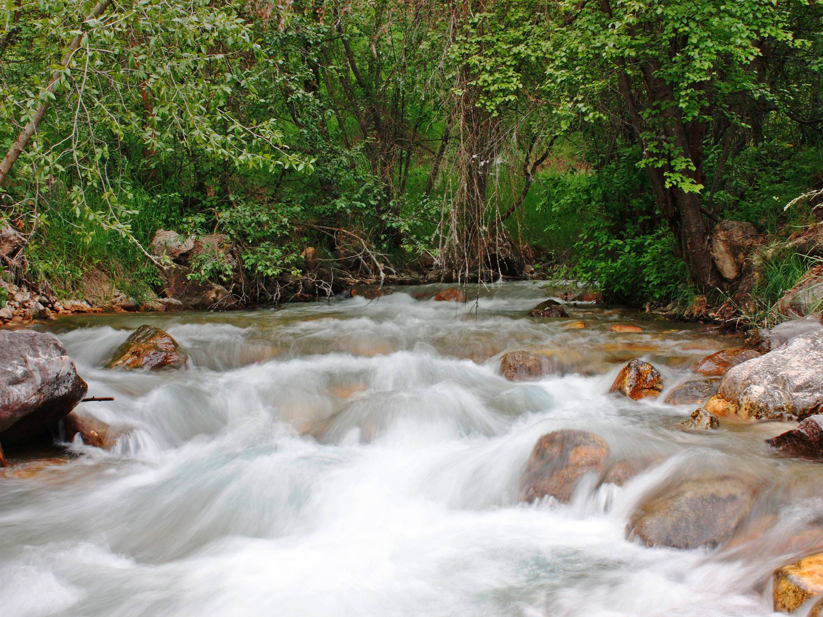
Questions, Discussion and Feedback
Notes:
Something needs to be done, but the specifics of how things get done are open for discussion.
We’re much more likely to be successful if agricultural producers are engaged in program development, so we need your ideas.
Highlighting concerns about these approaches will help us to develop implementation strategies that are most likely to succeed.

